Slide 1
Development of sikh nation
THE GURU IN THE PANTH

Slide 2
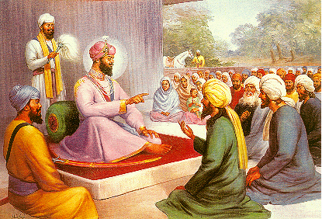
Guru intensifies character of Sikhs as individuals and increases their power thousand fold by filling their personalities with his own
In order to increase this power immensely more, the Guru made another arrangement.
He organized them into Sangats or Holy Assemblies, and put his personality again into them.
This led to a very remarkable development in the institution of Guruship, and no description of Guruship will be complete without an account of this development.

Slide 3
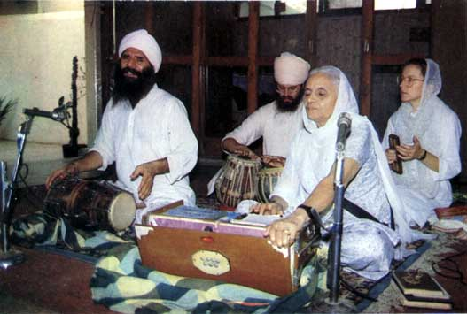
The Sikh idea of religion, as we have seen, was something more practical than merely mystic.
It was to consist of the practice of Nam and Sewa.
To practice Nam means to practice the presence of God by keeping Him ever in our minds by singing His praises or dwelling on His excellences.
This is to be done not only when alone in solitude, but also in public, where worship of the Name is made more impressive by being organized in the form of recitations or singing.

Slide 4
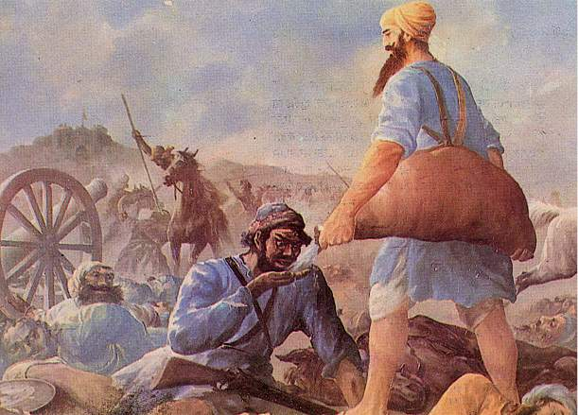
Sewa or Service.
The other element is Sewa or Service.
The idea of service is that it should be not only liberal, but also efficient and economical; that is, it should do the greatest good with the least possible means.
It should not be wasteful.
We do not set up a sledge-hammer to crack a nut, or send a whole army to collect revenue.
We have to be economical in our efforts, however charitable they may be
. For this purpose we have to organize our means.
Sewa panthis

Slide 5
In every work of practical nature, in which more than one person is engaged, it is necessary to resort to organization.
As religion too - especially a religion like Sikhism whose aim is to serve mankind - belongs to the same category
It requires organization of its followers as an essential condition of its success.
It may not be necessary in the case of an individualistic religion, wherein the highest aim is to vacate the mind of all desires, or to dream away the whole life in jungles or mountains;
But where religion consists in realizing God mainly through service done within the world, where men have constantly to deal with men to promote each others good, it is impossible to do without organization.

Slide 6
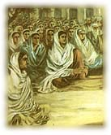
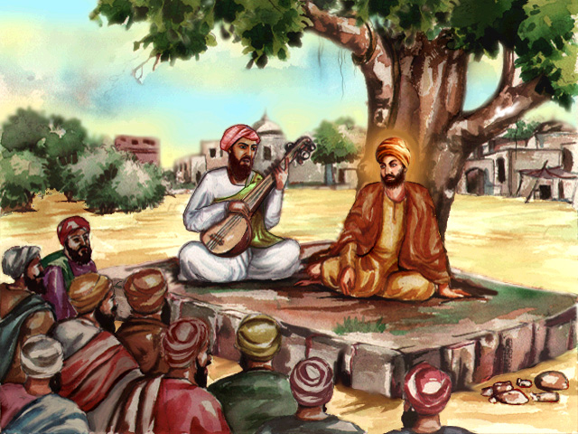
Guru Nanak had, therefore, begun with two things in his religious work: the holy Word and the organized Fellowship.
This organized fellowship is called Sangat or holy Fellowship led to the establishment of local assemblies led by authorized leaders, called Masands.
Every Sikh was supposed to be a member of one or other of such organizations.
The Guru was the central unifying personality and, in spite of changes in succession, was held to be one and the same as his predecessors.
Sangat or holy Fellowship
Masands. --Missionaries

Slide 7
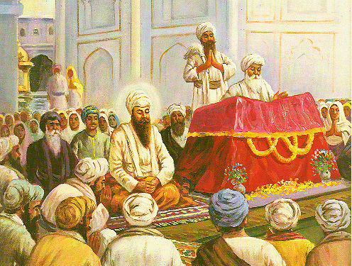
The love existing between the Guru and the Sikhs was more intense than has every existed between the most romantic lovers of the world.
But the homage paid to the Guru was made impersonal by creating a mystic unity between the Sikh and the Guru on the one hand and the Guru and the Word on the other.
Greatest respect began to be paid to the incorporated Word, even the Guru choosing for himself a seat lower than that of the Scripture.
The only form of worship was the meditation on and the singing of the Word.
Guru choosing for himself a seat lower than that of the Scripture

Slide 8
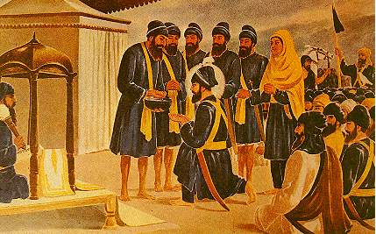
The Sikh assemblies also acquired great sanctity, owing to the belief that the spirit of the Guru lived and moved among them.
They began to assume higher and higher authority, until collectively the whole body, called the Panth, came to be regarded as an embodiment of the Guru.
Guru Gobind Singh himself received Amrit from the Sikhs initiated by himself.
After him the Sikhs ceased to have any personal Guru.

Slide 9
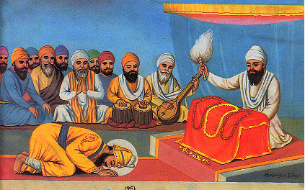
The Guru, as mentioned above, worked with two things: the personal association and the Word.
Now after the death of Guru Gobind Singh the personality and the Word were separated.
The Panth was invested with the personality of the Guru, and the incorporated Word became the Gyan Guru.
That is, in simple words, the Khalsa panth was to be the guru in future, not in super session of the previous Gurus, but al authorized to work in their name; and it was invariably to guide itself by the teachings of the Gurus as found in the Holy Granth.
So that the Sikhs came to name Guru Nanak and the Guru Panth in the same breath.

Slide 10
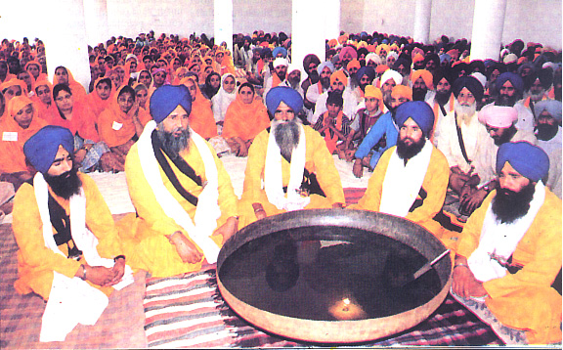
Amrit, (sometimes incorrectly mentioned as Sikh baptism) made, the basis of this holy organization.
There was no room left for any wavering on the border-line.
All who wanted to serve humanity through Sikhism must join it seriously as regular members, and receive its Amrit as the initial step.
All must have the same creed, which should be well-defined and should not be confused with the belief and practices of the neighboring religions.
The Guru ordered that --
The Khalsa should be distinct from the Hindu and the Muslim.
He who keeps alight the unquenchable torch of truth, and never swerves from the

Slide 11
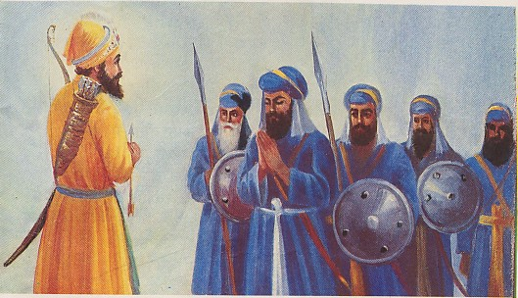
Such a Khalsa was to embody in himself the highest ideal of manhood, as described by Guru Gobind Singh in his unpublished book, called Sarb Loh.
Although the Khalsa was designed by the Guru himself, yet the Guru was so charmed by the look of his own creation that he saluted it, as his own ideal and master.
The Khalsa was thought fit enough to administer Amrit of the new order to the Guru, and was consecrated as the Guru incarnate.
As a sign that the Guru had placed himself eternally in his Sikhs, it was declared by him that--
If anybody wishes to see me, let him go to an assembly of Sikhs, and approach them with faith and reverence; he will surely see me amongst them.
Khalsa was was consecrated as the Guru incarnate.

Slide 12
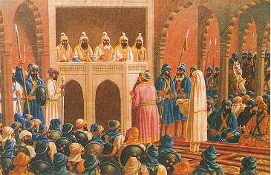
In the ranks of the Khalsa, all were equal, the lowest with the highest, in race as in creed, in political rights as in religious hopes.
Women were to be initiated in the same way as men and were to enjoy the same rights.
The “Sarbat Khalsa,” or the whole people, met once at the Akal Takht, Amritsar, the highest seat of Panthic authority, on the occasion of Dewali or Baisakhi, and felt that they were one.
All questions affecting the welfare of the community were referred to the Sangats, which would decide them in the form of resolutions called Gurmata duly passed was supposed to have received the sanction of the Guru, and any attempt made afterwards to contravene it was taken as a sacrilegious act.

